Slide 1
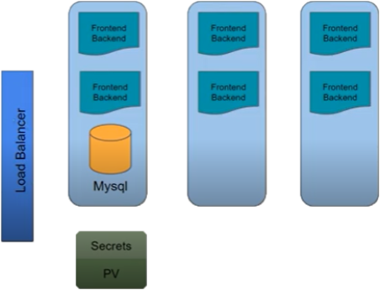
Node 1
Node 2
Node 3

